Slide 1
Memacu Keunggulan Jati Diri
Kepimpinan Menerusi Pendekatan
“Diversified Mastery Experiential Learning Merentas Kurikulum (DMeXL)”
Rorlinda Yusof, Afifah Mohd Radzi, Siti Noor Diana Mohd Kamaruddin,
Roslina Ahmad Faisal, Kamarul Zaman Hamzah, Md. Jais Ismail, Mohd Shafiz Md Shah
Pusat PERMATA@Pintar Negara, Universiti Kebangsaan Malaysia
SUPERVISOR:
MIMI ADIRA
MENTOR (if any):
MIMI ADIRA
MENTEE:
MIMI ADIRAH SULAIMAN
MIMI ADIRAH SULAIMAN
MIMI ADIRAH SULAIMAN

Slide 2
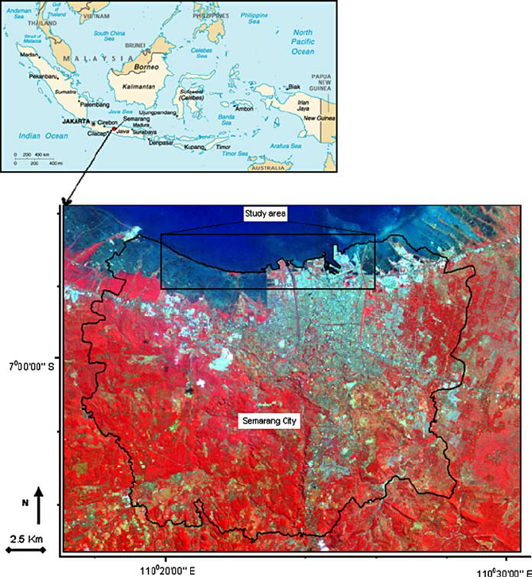
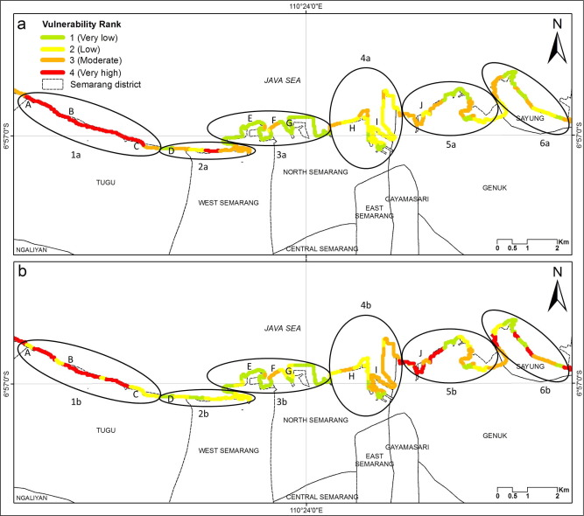
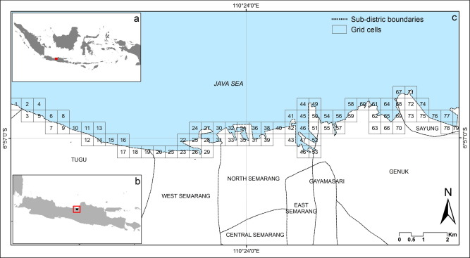
Memacu Keunggulan Jati Diri
Kepimpinan Menerusi Pendekatan
“Diversified Mastery Experiential Learning Merentas Kurikulum (DMeXL)”
Rorlinda Yusof, Afifah Mohd Radzi, Siti Noor Diana Mohd Kamaruddin,
Roslina Ahmad Faisal, Kamarul Zaman Hamzah, Md. Jais Ismail, Mohd Shafiz Md Shah
Pusat PERMATA@Pintar Negara, Universiti Kebangsaan Malaysia
Tidal flood is one of the disaster phenomena which occur frequently in Semarang coastal area, Indonesia. The impact of the tidal flood is increasing under enhanced land subsidence and changes of the coastal landuse. In the future, impact of tidal flood is predicted even worse with the scenario of sea level rise due to global warming. The coastal community is the most vulnerable group due to the flood. However, the coastal community has also capacity to adapt such condition. In more detail, tidal flood give impact to the daily activity, disturbing the accessibility and causes damage to the infrastructures. The coastal community has applied the structural and non-structural measurement including raising the floor, build the temporary dam in front of the house, creating dykes, increasing street levels in the neighborhood area, and some people have initiated to adjust the structure of the house to adapt such inundation (in local language: rumah panggung). However, in the future, it is necessary to set up tIre mitigation action based on the community participation in order to reduce the risk on the coastal area.
Tidal flood is one of the disaster phenomena which occur frequently in Semarang coastal area, Indonesia. The impact of the tidal flood is increasing under enhanced land subsidence and changes of the coastal landuse.
In the future, impact of tidal flood is predicted even worse with the scenario of sea level rise due to global warming. The coastal community is the most vulnerable group due to the flood. However, the coastal community has also capacity to adapt such condition. In more detail, tidal flood give impact to the daily activity, disturbing the accessibility and causes damage to the infrastructures. The coastal community has applied the structural and non-structural measurement including raising the floor, build the temporary dam in front of the house, creating dykes, increasing street levels in the neighborhood area, and some people have initiated to adjust the structure of the house to adapt such inundation (in local language: rumah panggung). However, in the future, it is necessary to set up tIre mitigation action based on the community participation in order to reduce the risk on the coastal area.
In the future, impact of tidal flood is predicted even worse with the scenario of sea level rise due to global warming. The coastal community is the most vulnerable group due to the flood. However, the coastal community has also capacity to adapt such condition. In more detail, tidal flood give impact to the daily activity, disturbing the accessibility and causes damage to the infrastructures. The coastal community has applied the structural and non-structural measurement including raising the floor, build the temporary dam in front of the house, creating dykes, increasing street levels in the neighborhood area, and some people have initiated to adjust the structure of the house to adapt such inundation (in local language: rumah panggung). However, in the future, it is necessary to set up tIre mitigation action based on the community participation in order to reduce the risk on the coastal area.
However, the coastal community has also capacity to adapt such condition. In more detail, tidal flood give impact to the daily activity, disturbing the accessibility and causes damage to the infrastructures. The coastal community has applied the structural and non-structural measurement including raising the floor, build the temporary dam in front of the house, creating dykes, increasing street levels in the neighborhood area, and some people have initiated to adjust the structure of the house to adapt such inundation (in local language: rumah panggung). However, in the future, it is necessary to set up tIre mitigation action based on the community participation in order to reduce the risk on the coastal area.
Tidal flood is one of the disaster phenomena which occur frequently in Semarang coastal area, Indonesia. The impact of the tidal flood is increasing under enhanced land subsidence and changes of the coastal landuse.
In the future, impact of tidal flood is predicted even worse with the scenario of sea level rise due to global warming. The coastal community is the most vulnerable group due to the flood. However, the coastal community has also capacity to adapt such condition. In more detail, tidal flood give impact to the daily activity, disturbing the accessibility and causes damage to the infrastructures. The coastal community has applied the structural and non-structural measurement including raising the floor, build the temporary dam in front of the house, creating dykes, increasing street levels in the neighborhood area, and some people have initiated to adjust the structure of the house to adapt such inundation (in local language: rumah panggung). However, in the future, it is necessary to set up tIre mitigation action based on the community participation in order to reduce the risk on the coastal area.
Tidal flood is one of the disaster phenomena which occur frequently in Semarang coastal area, Indonesia. The impact of the tidal flood is increasing under enhanced land subsidence and changes of the coastal landuse.
In the future, impact of tidal flood is predicted even worse with the scenario of sea level rise due to global warming. The coastal community is the most vulnerable group due to the flood. However, the coastal community has also capacity to adapt such condition. In more detail, tidal flood give impact to the daily activity, disturbing the accessibility and causes damage to the infrastructures. The coastal community has applied the structural and non-structural measurement including raising the floor, build the temporary dam in front of the house, creating dykes, increasing street levels in the neighborhood area, and some people have initiated to adjust the structure of the house to adapt such inundation (in local language: rumah panggung). However, in the future, it is necessary to set up tIre mitigation action based on the community participation in order to reduce the risk on the coastal area.
EXAMPLE
Tidal flood is one of the disaster phenomena which occur frequently in Semarang coastal area, Indonesia. The impact of the tidal flood is increasing under enhanced land subsidence and changes of the coastal landuse.
In the future, impact of tidal flood is predicted even worse with the scenario of sea level rise due to global warming. The coastal community is the most vulnerable group due to the flood. However, the coastal community has also capacity to adapt such condition. In more detail, tidal flood give impact to the daily activity, disturbing the accessibility and causes damage to the infrastructures. The coastal community has applied the structural and non-structural measurement including raising the floor, build the temporary dam in front of the house, creating dykes, increasing street levels in the neighborhood area, and some people have initiated to adjust the structure of the house to adapt such inundation (in local language: rumah panggung). However, in the future, it is necessary to set up tIre mitigation action based on the community participation in order to reduce the risk on the coastal.
Tidal flood is one of the disaster phenomena which occur frequently in Semarang coastal area, Indonesia. The impact of the tidal flood is increasing under enhanced land subsidence and changes of the coastal landuse.
In the future, impact of tidal flood is predicted even worse with the scenario of sea level rise due to global warming. The coastal community is the most vulnerable group due to the flood. However, the coastal community has also capacity to adapt such condition. In more detail, tidal flood give impact to the daily activity, disturbing the accessibility and causes damage to the infrastructures. The coastal community has applied the structural and non-structural measurement including raising the floor, build the temporary dam in front of the house, creating dykes, increasing street levels in the neighborhood area, and some people have initiated to adjust the structure of the house to adapt such inundation (in local language: rumah panggung). However, in the future, it is necessary to set up tIre mitigation action based on the community participation in order to reduce the risk on the coastal.
SUPERVISOR:
MIMI ADIRA
MENTOR (if any):
MIMI ADIRA
MENTEE:
MIMI ADIRAH SULAIMAN
MIMI ADIRAH SULAIMAN
MIMI ADIRAH SULAIMAN

