Slide 1
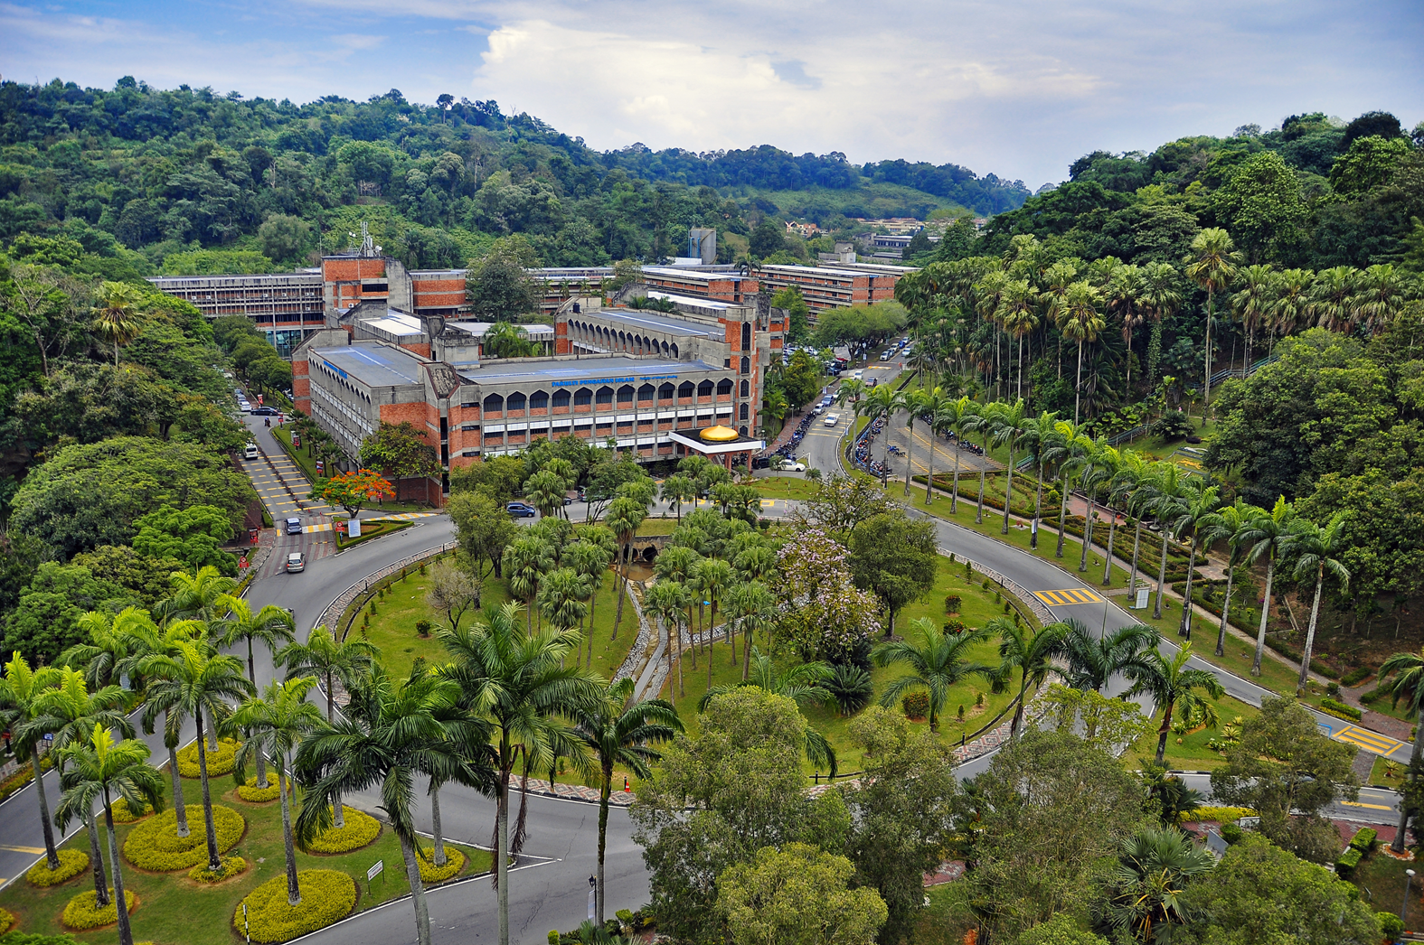
BROCHURE POSTGRADUATE SESSION 2024/2025
www.ukm.my/akademik/

Slide 2
FACULTY OF ECONOMICS & MANAGEMENT
DOCTOR OF PHILOSOPHY
Candidate may choose any specialization as follows:
ECONOMICS
Behavioural Economics
Development Economics and Community
Digital Economy
Econometrics
Economics of Human Resource Development
Fiscal and Monetary Economics
Industrial Economics
International Economics
Islamic Economics and Finance
Tourism and Hospitality Economics
MANAGEMENT
Big Data Management
Change Management
Consumer Behaviour
Digital Marketing
Ethics and Professionalism
Finance
Financial Behaviour
Financial Literacy
Financial Technology (Fintech)
Global Business
Human Resource Management
Islamic Finance
Knowledge Management
Leadership
Operations Management and Logistic
Organisational Behaviour
Retail Marketing
Risk Management
Services Marketing
Strategic Management
Stress Management and Ergonomics
Waqf Management
Mode of Study: Research
Registration Status:
Full Time & Part Time
Lectures: During weekdays and office hours (including part-time)
ACCOUNTING
Accountability and Management Control
Accounting and Finance Services
Accounting Information System
Auditing and Assurance Services
Business Law
Corporate Governance and Integrity
Corporate Reporting
Intellectual Capital
Public Sector Accounting
Sustainable Accounting
Taxation
ENTREPRENEURSHIP
E-Entrepreneurship
Entrepreneurship
Innovation Management
International Entrepreneurship
Social Entrepreneurship
Value Creation
Family Business
Franchising Business
+603-8921 5775 / 5777
postgradfep@ukm.edu.my
www.ukm.my/fep/siswazah

Slide 3
FACULTY OF ECONOMICS & MANAGEMENT
DOCTOR OF PHILOSOPHY (ECONOMICS)
Financial Economics and Banking
Fiscal and Monetary Economics
Development Economics
Human Resources Economics
International Trade and Industrial Economics
Environmental, Resource and Agricultural Economics
Applied Econometrics
Islamic Economics and Finance
Mode of Study: Mixed Mode (Coursework & Research)
Registration Status: Full Time & Part Time
Lectures: During weekdays and office hours (including part-time)
+603-8921 5775 / 5777
postgradfep@ukm.edu.my
www.ukm.my/fep/siswazah

Slide 4
FACULTY OF ECONOMICS & MANAGEMENT
ECONOMICS
Behavioural Economics
Development Economics and Community
Digital Economy
Econometrics
Economics of Human Resource Development
Fiscal and Monetary Economics
Industrial Economics
International Economics
Islamic Economics and Finance
Tourism and Hospitality Economics
ISLAMIC ECONOMICS
Islamic Banking
Islamic Finance
ACCOUNTING
Accountability and Management Control
Accounting and Finance Services
Accounting Information System
Auditing and Assurance Services
Business Law
Corporate Governance and Integrity
Corporate Reporting
Intellectual Capital
Public Sector Accounting
Sustainable Accounting
Taxation
MASTER OF COMMERCE
FINANCE
Finance
Financial Behaviour
Financial Literacy
Financial Technology (Fintech)
Islamic Finance
Risk Management
MANAGEMENT
Big Data Management
Change Management
Consumer Behaviour
Digital Marketing
Ethics and Professionalism
Global Business
Human Resource Management
Knowledge Management
Leadership
Operations Management and Logistic
Organisational Behaviour
Retail Marketing
Services Marketing
Strategic Management
Stress Management and Ergonomics
Waqf Management
ENTREPRENEURSHIP
E-Entrepreneurship
Entrepreneurship
Innovation Management
International Entrepreneurship
Social Entrepreneurship
Value Creation
Family Business
Franchising Business
Mode of Study: Research
Registration Status: Full Time & Part Time
Lectures: During weekdays and office hours (including part-time)
+603-8921 5775 / 5777
postgradfep@ukm.edu.my
www.ukm.my/fep/siswazah

Slide 5
FACULTY OF ECONOMICS & MANAGEMENT
MASTER IN ACCOUNTING
Mode of Study: Coursework
Registration Status: Full Time & Part Time
Lectures: During weekdays and office hours (including part-time)
MASTER IN ECONOMICS
Modules:
Agricultural and Applied Economics
Development Economics
Econometrics
Environmental and Resource Economics
Human Resource Economics
Industrial Economic
International Economics
Islamic Economics
Monetary Economics
Public Economics
Mode of Study: Coursework
Registration Status: Full Time & Part Time
Lectures: During weekdays and office hours (including part-time)
MASTER IN ISLAMIC ECONOMICS
Modules:
Islamic Banking
Islamic Finance
Mode of Study: Coursework
Registration Status: Full Time & Part Time
Lectures: During weekdays and office hours (including part-time)
MASTER IN ENTREPRENEURSHIP AND INNOVATION
Mode of Study: Coursework
Registration Status: Full Time & Part Time
Lectures: During weekdays and office hours (including part-time)
MASTER IN PUBLIC ADMINISTRATION AND LEADERSHIP
Mode of Study: Coursework
Registration Status: Full Time & Part Time
Lectures: Saturday & Sunday
+603-8921 5775 / 5777
postgradfep@ukm.edu.my
www.ukm.my/fep/siswazah

Slide 6
INSTITUTE OF MALAYSIAN & INTERNATIONAL STUDIES
Entry requirements for doctoral programmes
(a) A person who intends to apply for a doctoral programme should have the following qualifications:
(i) Master's Degree from a University or any institution of higher learning recognized by the Malaysian Qualifications Agency (MQA) and/or have accreditation recognized by a foreign Accreditation Body, or an institution with accreditation as prescribed by a programme;
(ii) other qualifications equivalent to a masters degree or other qualifications with experience recognised by the Senate; or
(iii) a student currently pursuing full-time master’s programme under sub-regulation 6(a) at the University and recommended by the Faculty’s/Institute’s Graduate Studies Committee for status conversion to a doctoral programme with approval from the Dean/Director; or
(iv) Bachelor Degree with distinction from the University or any institution of higher learning subject to what is prescribed by the Faculty/Institute and approval by Malaysian Qualifications Agency (MQA); and/or with accreditation recognised by a foreign Accreditation Board.
(v) any other qualification recognised by the Senate obtained through the Accreditation of Prior Experiential Learning (APEL); or
(vi) fulfils other requirements prescribed by the programme (if applicable); and
(vii) fulfils requirements of the Malaysian Qualifications Agency (MQA).
23 September 2024
https://join.ukm.my

Slide 7
INSTITUTE OF MALAYSIAN & INTERNATIONAL STUDIES
Entry Requirements for Master’s Programmes
(a) A person who intends to apply for a master’s programme should have the following qualifications:
(i) Bachelor's Degree by obtaining a good Cumulative Grade Point Average (CGPA) from a University or any institution of higher learning recognized by the Malaysian Qualifications Agency (MQA) and/or having accreditation recognized by a foreign Accreditation Body, or institution who has accreditation as prescribed by a programme;
(ii) Doctor of Medicine degree or Doctor of Dental Surgery degree from the University or any institution of higher learning or an equivalent degree from any institutions of higher learning recognised by the Senate;
(iii) any other qualification recognised by the Senate obtained through the Accreditation of Prior Experiential Learning (APEL);
(iv) fulfils other requirements prescribed by the programme (if applicable); and
(v) fulfils requirements of the Malaysian Qualifications Agency (MQA).
Candidates have to apply online via https://join.ukm.my
starting 23 September 2024.
For any enquiries, please contact:
Local Applicants
Centre for Academic Management
Universiti Kebangsaan Malaysia
E-mail: admission_ppa@ukm.edu.my
Tel no.: 03-8911 8468 / 8389
International Applicants
Shaping Advanced & Professional Education Center (UKMShape)
Level 2, Bangunan Wawasan
Universiti Kebangsaan Malaysia
E-mail: admission.shape@ukm.edu.my
Tel no.: 03-8927 2129 / 2112
23 September 2024
https://join.ukm.my

