Slide 1
Situation
Indiana Jones, the world famous archeologist, is currently in Kampung Buluh, Kuala Berang, Terengganu, leading an expedition in search of artifacts. The dig is in progress when suddenly an excited shout broke the momentum. A clamor of activity ensued. From beyond the steep sloping bank of Tersat River, cries of joy were heard. An artifact has been unearthed.

Slide 2
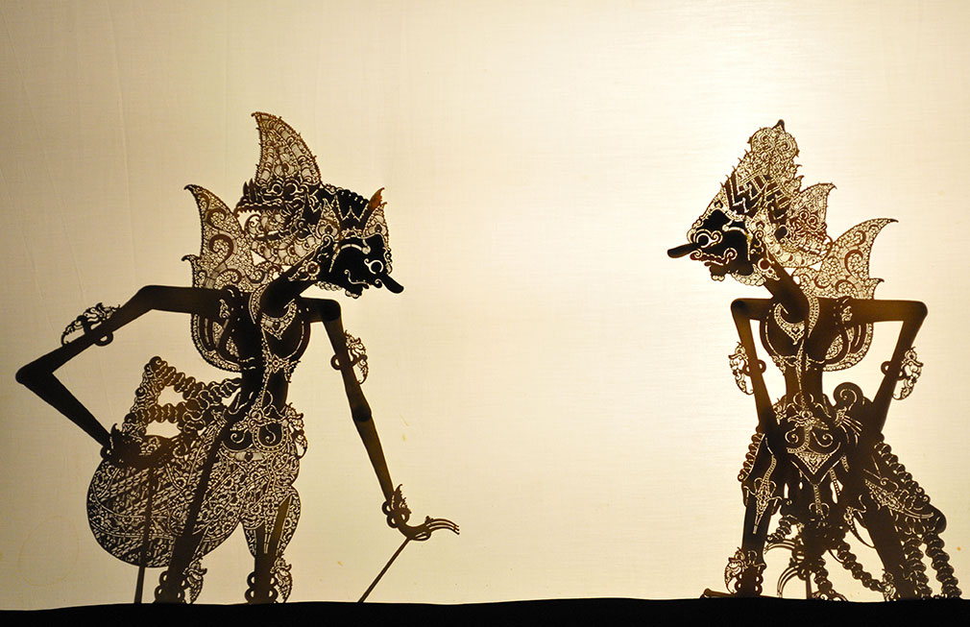
Write and role-play a 10-minute sketch.

